Slide 1
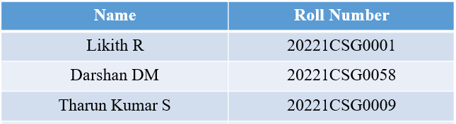
Geo Tagging of Land Properties Using Drones
CSE7101- Capstone Project
Review-2
Batch Number: CSG_30
Under the Supervision of,
Ms. Riya Sanjesh
Assistant Professor
School of Computer Science and Engineering
Presidency University
Roll Number | Student Name
Name of the Program: B-tech, CST-AIML
Name of the HoD: Dr. Saira Banu
Name of the Program Project Coordinator: Dr. H M Manjula
Name of the School Project Coordinators: Dr. Sampath A K , Dr. Geetha A

Slide 2
Content
Abstract
Literature Survey
Objectives
Existing Methods and Drawbacks
Proposed Methods & Feasibility Study
Architecture Diagram
Modules
Hardware and Software Details
Timeline (Gnatt Chart)
GitHub Link of the Project:
References

Slide 3
Abstract :
Geo-tagging of land properties is a critical requirement in modern urban planning, real estate, and land management. Traditional surveying methods are time-consuming, labor-intensive, and prone to human error. With the rapid development of Unmanned Aerial Vehicles (UAVs), drones offer a cost-effective, accurate, and efficient approach to land mapping. This project focuses on designing a drone-based system to capture aerial imagery, process the data using Geographic Information Systems (GIS), and automatically assign geo-tags to land parcels. The approach aims to improve land records, reduce disputes, and support government digitization initiatives

Slide 4
Objectives :
To design a cost-effective drone-based surveying framework.
To achieve accuracy levels comparable to or better than manual cadastral surveys.
To automate property boundary detection using computer vision.
To integrate data with GIS for scalable land management.
To support government e-governance and smart city initiatives.
To reduce survey timelines by at least 50% compared to conventional methods.
To make the system user-friendly for field officers and non-technical staff.

Slide 5
Existing Methods and Drawbacks :
Conventional Ground Surveys – Precise but extremely time-consuming and labor-intensive.
Satellite Remote Sensing – Large coverage but lacks resolution for small plots, affected by cloud cover.
Handheld GPS Survey Devices – Portable but prone to operator error, and often lack integration with GIS.
Aerial Photogrammetry (Manned Aircrafts) – Accurate but expensive and requires skilled pilots.
Commercial Drone Surveying Services – Available but cost-prohibitive for small landowners and local governments.
GIS-based Manual Entry – Requires heavy manpower to digitize land records, prone to data inconsistency.

Slide 6
Proposed Methods & Feasibility Study :
Drone System: Deploy UAVs with GPS and high-resolution cameras for aerial image capture.
Processing Pipeline: Apply photogrammetry to stitch images into an orthomosaic map.
Boundary Extraction: Use computer vision and machine learning to detect land parcel boundaries.
Geo-Tagging: Assign latitude–longitude coordinates to detected boundaries and integrate with GIS.
Feasibility Justification:
Technology: Readily available UAVs and open-source GIS software.
Cost: Lower operational costs than manual or satellite surveys.
Scalability: Can be applied in both rural and urban contexts.
Accuracy: Capable of centimeter-level precision depending on drone sensors.
Legal Compliance: Aligns with digital land record initiatives like India’s Digital India Land Records Modernization Programme (DILRMP).

Slide 7
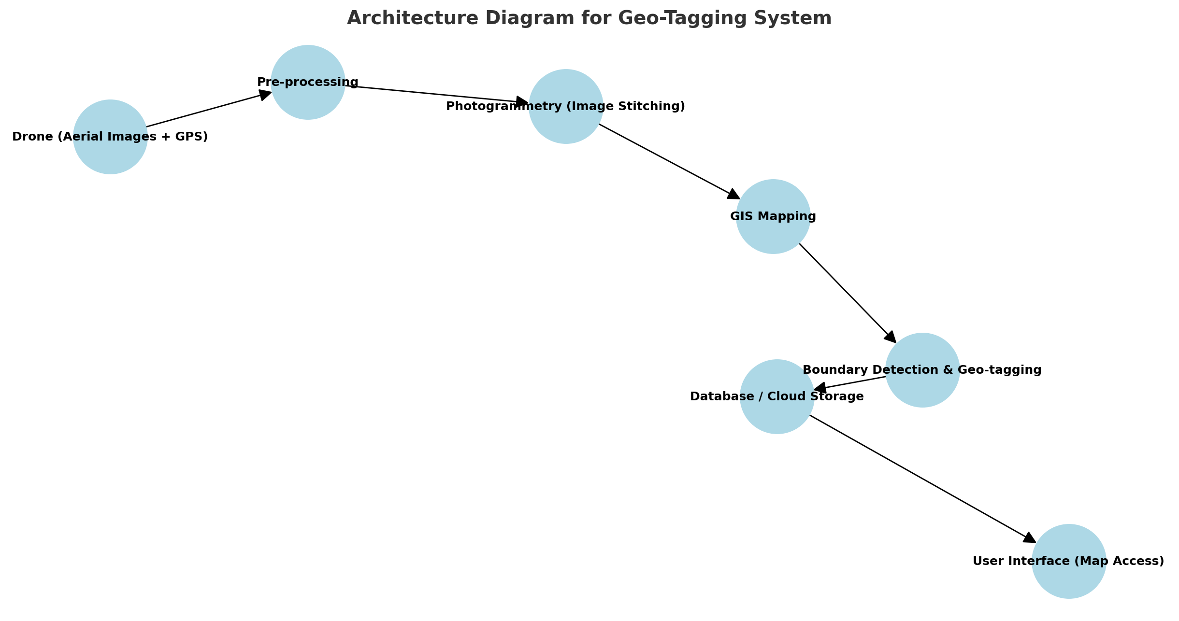
Architecture Diagram :

Slide 8
Modules :
Drone Data Acquisition – Flight planning, aerial image capture with GPS tagging.
Image Pre-processing – Noise removal, correction of distortions, calibration of images.
Photogrammetry & Stitching – Generation of orthomosaic maps and 3D terrain models.
Boundary Detection – ML algorithms identify property boundaries automatically.
Geo-Tagging & Database Integration – Each parcel gets unique coordinates stored in GIS.
Visualization Module – Interactive map display with zoom, search, and overlay features.
Validation Module – Cross-check with government records and ground truthing.

Slide 9
Software and Hardware Requirements :
Hardware | Software
UAV with GPS + IMU (Inertial Measurement Unit) | Photogrammetry: Pix4D, Agisoft Metashape, DroneDeploy
High-resolution RGB camera (12–20 MP minimum) | GIS Mapping: ArcGIS, QGIS (open source)
Optional LiDAR sensor for terrain mapping | Programming/ML: Python, TensorFlow, OpenCV for boundary detection)
Ground Control Station (laptop, tablet) | Database: PostgreSQL + PostGIS for spatial data
Battery packs, charging station, communication modules | Visualization: WebGIS dashboards (Leaflet, Mapbox, Google Earth Engine)

Slide 10
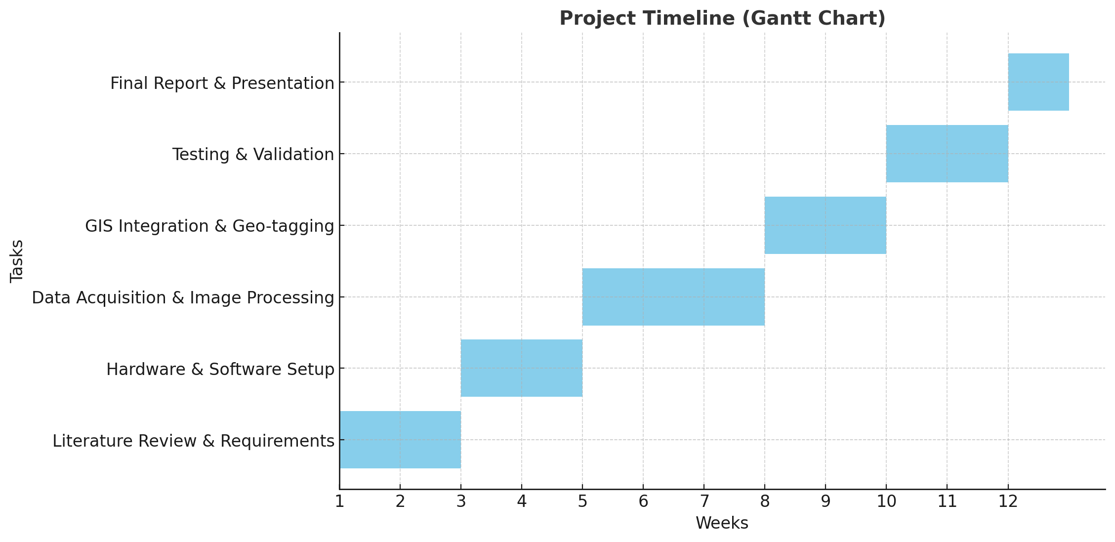
Timeline (Gantt Chart) :

Slide 11
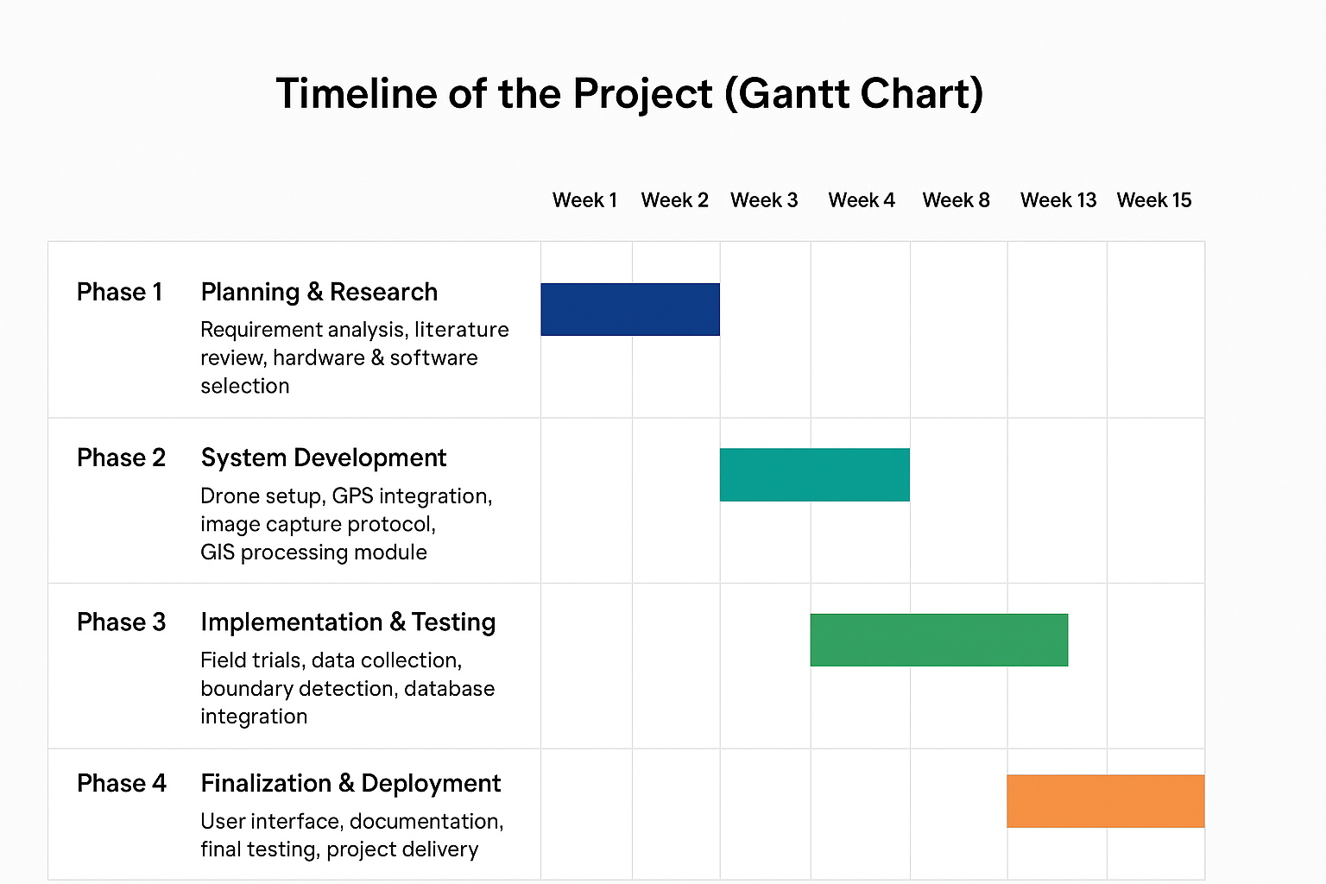
Timeline (Gantt Chart) : (contd...)
Phase | Description | Duration
Phase 1 | Planning & Research – Requirement analysis, literature review, hardware & software selection | Week 1 – Week 3
Phase 2 | System Development – Drone setup, GPS integration, image capture protocol, GIS processing module | Week 4 – Week 8
Phase 3 | Implementation & Testing – Field trials, data collection, boundary detection, database integration | Week 9 – Week 12
Phase 4 | Finalization & Deployment – User interface, documentation, final testing, project delivery | Week 13 – Week 15

Slide 12
GitHub Link of the Project:
Source Code Repository:
https://github.com/Likith1804/Geo-Tagging-of-Land-Properties-Using-Drones

Slide 13
References (IEEE Paper format)
[1] J. Xia, J. Li, H. Wang, and M. Lemmen, “Extracting cadastral boundaries from UAV imagery using deep learning,” Int. Arch. Photogramm. Remote Sens. Spatial Inf. Sci., vol. XLII-2/W13, pp. 1–8, 2019. https://ris.utwente.nl/ws/files/284378453/Xia_2019_Extracting_cadastral_boundaries_fro.pdf
[2] A. Radwan and M. E. Hassib, “Geo-localization using aerial imagery: Progress and future outlook,” arXiv preprint arXiv:1709.01813, Sep. 2017. https://arxiv.org/pdf/1709.01813
[3] S. Crommelinck, M. Koeva, and M. Gerke, “Towards cadastral intelligence: Boundary delineation from UAV imagery using deep learning,” Remote Sens., vol. 11, no. 14, p. 1725, 2019. https://research.utwente.nl/files/121598376/Crommelinck_2019_Towards_Cadastral_Intelligenc.pdf
[4] J. Wang, L. Zhang, and Z. Chen, “Cross-view geo-localization with aerial and ground images,” arXiv preprint arXiv:2108.03344, Aug. 2021. https://arxiv.org/pdf/2108.03344.pdf

Slide 14
References (IEEE Paper format) : (contd...)
[5] T. Weyand, I. Kostrikov, and J. Philbin, “Planet-photo geolocation with convolutional neural networks,” arXiv preprint arXiv:1203.2386, Mar. 2012. https://arxiv.org/pdf/1203.2386.pdf
[6] J. Hays and A. A. Efros, “IM2GPS: Estimating geographic information from a single image,” arXiv preprint arXiv:1205.5742, May 2012. https://arxiv.org/pdf/1205.5742.pdf
[7] H. Chen, Z. Li, and W. Sun, “Drone-based geo-localization using multi-modal data fusion,” arXiv preprint arXiv:2502.11044, Feb. 2025. https://arxiv.org/pdf/2502.11044.pdf
[8] M. K. Petersen, S. O. Andersen, and T. G. Santos, “Instant bridge visual inspection using an unmanned aerial vehicle,” NTNU Open Archive, Master Thesis, 2020. https://ntnuopen.ntnu.no/ntnu-xmlui/bitstream/handle/11250/2673476/Instant%20bridge%20visual%20inspection%20using%20an%20unmanned%20aerial%20vehicle.pdf

Slide 15
References (IEEE Paper in Excel Format) : (contd...)
Authors | Title | Journal/Conference | Volume/Issue/Pages | Year | Link
J. Xia, J. Li, H. Wang, and M. Lemmen | Extracting cadastral boundaries from UAV imagery using deep learning | Int. Arch. Photogramm. Remote Sens. Spatial Inf. Sci. | vol. XLII-2/W13, pp. 1–8 | 2019 | https://ris.utwente.nl/ws/files/284378453/Xia_2019_Extracting_cadastral_boundaries_fro.pdf
A. Radwan and M. E. Hassib | Geo-localization using aerial imagery: Progress and future outlook | arXiv preprint | arXiv:1709.01813 | 2017 | https://arxiv.org/pdf/1709.01813
S. Crommelinck, M. Koeva, and M. Gerke | Towards cadastral intelligence: Boundary delineation from UAV imagery using deep learning | Remote Sens. | vol. 11, no. 14, p. 1725 | 2019 | https://research.utwente.nl/files/121598376/Crommelinck_2019_Towards_Cadastral_Intelligenc.pdf
J. Wang, L. Zhang, and Z. Chen | Cross-view geo-localization with aerial and ground images | arXiv preprint | arXiv:2108.03344 | 2021 | https://arxiv.org/pdf/2108.03344.pdf
T. Weyand, I. Kostrikov, and J. Philbin | Planet-photo geolocation with convolutional neural networks | arXiv preprint | arXiv:1203.2386 | 2012 | https://arxiv.org/pdf/1203.2386.pdf
J. Hays and A. A. Efros | IM2GPS: Estimating geographic information from a single image | arXiv preprint | arXiv:1205.5742 | 2012 | https://arxiv.org/pdf/1205.5742.pdf
H. Chen, Z. Li, and W. Sun | Drone-based geo-localization using multi-modal data fusion | arXiv preprint | arXiv:2502.11044 | 2025 | https://arxiv.org/pdf/2502.11044.pdf
M. K. Petersen, S. O. Andersen, and T. G. Santos | Instant bridge visual inspection using an unmanned aerial vehicle | NTNU Open Archive | Master Thesis | 2020 | https://ntnuopen.ntnu.no/ntnu-xmlui/bitstream/handle/11250/2673476/Instant%20bridge%20visual%20inspection%20using%20an%20unmanned%20aerial%20vehicle.pdf
K. Liu, F. Zhang, and J. Luo | Semantic aerial-ground image geo-localization with contrastive learning | arXiv preprint | arXiv:2508.14558 | 2025 | https://arxiv.org/pdf/2508.14558.pdf
D. Li, Y. Zhao, and H. Huang | Deep learning for cadastral mapping: Opportunities and challenges | Geocarto Int. | pp. 1–19 | 2024 | https://www.tandfonline.com/doi/pdf/10.1080/10106049.2024.2357690

Slide 16


